Slide 1
STOR 455 Class 19
Read: 3.4,
Exercises:

Slide 2
Comparing Two Regression Lines (with a multiple regression)
Example:
Y=Active pulse
X₁= Resting pulse X₂=Sex (0,1)
Quantitative
Indicator
Interaction

Slide 3
Multiple regression model
$$Y=β_{0}+β_{1}X_{1}+β_{2}X_{2}+…+β_{k}X_{k}+ε$$
We can test…
One term at a time: (t-test)
H_{o}: β_{i}=0
H_{a}: β_{i}≠0
All terms at once: (ANOVA)
H_{o}: β₁= β₂= ...=β_{k}= 0
H_{a}: Some β_{i}≠0
Is there anything in between?

Slide 4
Tests to Compare Two Regression Lines
$$Y=β_{0}+β_{1}X_{1}+β_{2}X_{2}+β_{3}X_{1}X_{2}+ε$$
How do we test just a subset of predictors?
Different slope?
H_{o}: β₃ = 0
H_{a}: β₃ ≠ 0
(t-test)
Different intercept?
H_{o}: β₂ = 0
H_{a}: β₂ ≠ 0
(t-test)
Different lines?
H_{o}: β₂ =β₃ = 0
H_{a}: β₂ ≠ 0 or β₃ ≠ 0
(???)

Slide 5
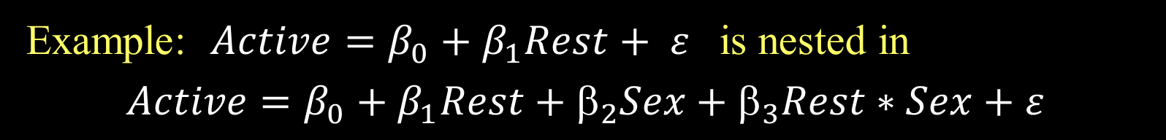
Nested Models
Definition: If all of the predictors in Model A are also in a bigger Model B, we say that Model A is nested in Model B.
Example: $Active=β_{0}+β_{1}Rest+ ε$ is nested in
$$Active=β_{0}+β_{1}Rest+_{2}Sex+_{3}Rest∗Sex+ε$$
Test for Nested Models:
Do we really need the extra terms in Model B?
i.e. How much do they “add” to Model A?

Slide 6
Nested F-test
Basic idea:
1. Find how much “extra” variability is explained when the “new” terms being tested are added.
2. Divide by the number of new terms to get a mean square for the new part of the model.
3. Divide this mean square by the MSE for the “full” model to get an F-statistic.
4. Compare to an F-distribution to find a p-value.

Slide 7
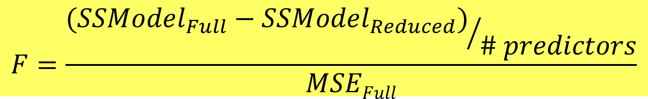
Nested F-test
Test: H_{o}: β_{i}=0 for a “subset” of predictors
H_{a}: β_{i}≠0 for some predictors in the subset
Explained by full model
Explained by reduced model
$$F=\frac{{(SSModel_{Full}−SSModel_{Reduced})}/{\# predictors}}{MSEFull}$$
#predictors tested in H₀
Based on full model
Compare to F-distribution

Slide 8
Nested F-test
$$Active =β_{0}+β1Rest+_{2}Sex+ 3RestSex +ε$$
H₀: β₂=β₃=0
H_{a}: Some β_{i}≠0
Compare mean square for the “extra” variability to the mean square error for the full model.
anova(modelP_Reduced, modelPint)
Analysis of Variance Table
Model 1: Active ~ Rest
Model 2: Active ~ Rest + Sex + Rest * Sex
Res.Df RSS Df Sum of Sq F Pr(>F)
1 373 75050
2 371 74538 2 512.14 1.2746 0.2808

Slide 9
Example: State SAT Scores
Source: Statistical Sleuth, Case 12.1 pg. 339
Response Variable:
SAT =Average combined SAT Score
Potential Predictors:
Takers = % taking the exam
Income = median family income ($100’s)
Years = avg. years of study (SS, NS, HU)
Public = % public school
Expend = spend per student ($100’s)
Rank = median class rank of takers

Slide 10
R: Best Subsets for StateSAT
library(leaps)
all=regsubsets(SAT~., data=StateSAT[2:8],nbest=2)
ShowSubsets(all)
Takers Income Years Public Expend Rank Rsq adjRsq Cp
1 ( 1 ) * 77.42 76.95 34.03
1 ( 2 ) * 73.58 73.03 47.64
2 ( 1 ) * * 84.71 84.05 10.22
2 ( 2 ) * * 80.54 79.71 24.97
3 ( 1 ) * * * 87.11 86.27 3.69
3 ( 2 ) * * * 85.84 84.91 8.21
4 ( 1 ) * * * * 87.71 86.61 3.58
4 ( 2 ) * * * * 87.67 86.57 3.72
5 ( 1 ) * * * * * 87.87 86.49 5.00
5 ( 2 ) * * * * * 87.73 86.34 5.48
6 ( 1 ) * * * * * * 87.87 86.18 7.00
SATbestmod = lm(SAT~Years+Public+Expend+Rank, data=StateSAT)

Slide 11
Model Selection with Categorical and Interaction Predictors
Use each of the four model selection methods discussed in class (AllSubsets, Backwards, Forwards, and Stepwise) and compare the processes and outcomes for the predictor pool:
Rest, Exercise, Hgt, Wgt, Rest & Exercise, Hgt & Exercise, and Wgt & Exercise

Slide 12
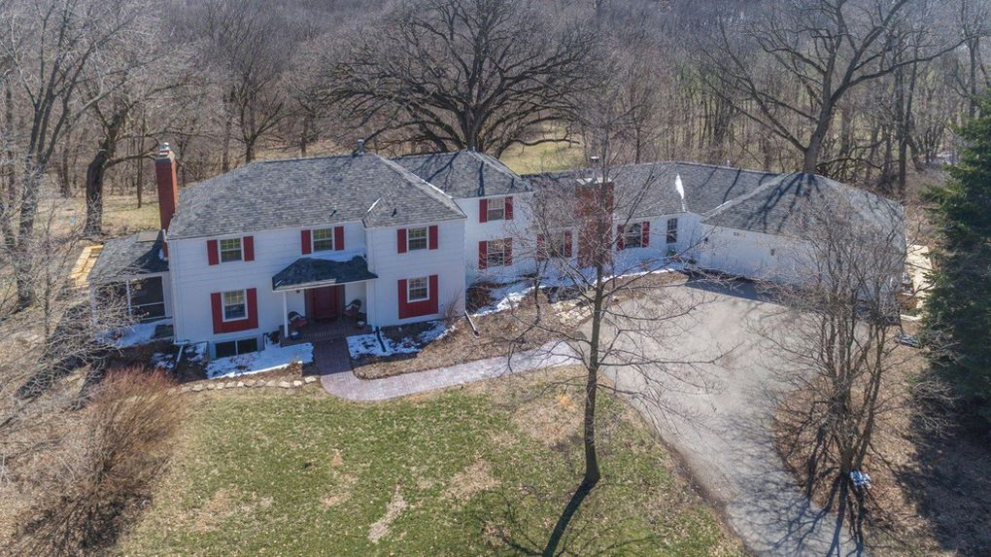
Assignment #3
Ames Iowa Housing Prices

Slide 13

Assignment #4
Suppose that you are interested in purchasing a used car. How much should you expect to pay? Obviously, the price will depend on the type of car you get (the model) and how much it's been used. For this assignment you will investigate how the price might depend on the age, mileage, and state where purchased.

